Slide 1
Azure Databricks - Workshop
Brian Denicola
Farah Omer
Jake Wang
aka.ms/fsidbnotebooks

Slide 2
Agenda
1:00 pm – 1:30 pm – Introduction - Overview
1:30 pm - 4:30 pm – Hands on Labs
4:30 pm – 5:00 pm – Wrap-up
Notes:
All kinds of data being generated
Stored on-premises and in the cloud – but vast majority in hybrid
Reason over all this data without requiring to move data
They want a choice of platform and languages, privacy and security
<Transition> Microsoft’s offerng

Slide 3
The modern data estate
LOB
CRM
Graph
Image
Social
IoT
Hybrid
Operational databases
Operational databases
Data warehouses
Data warehouses
Data Lakes
Data Lakes
Reason over any data, anywhere
Flexibility of choice
Security and performance
Notes:
All kinds of data being generated
Stored on-premises and in the cloud – but vast majority in hybrid
Reason over all this data without requiring to move data
They want a choice of platform and languages, privacy and security
<Transition> Microsoft’s offerng

Slide 4
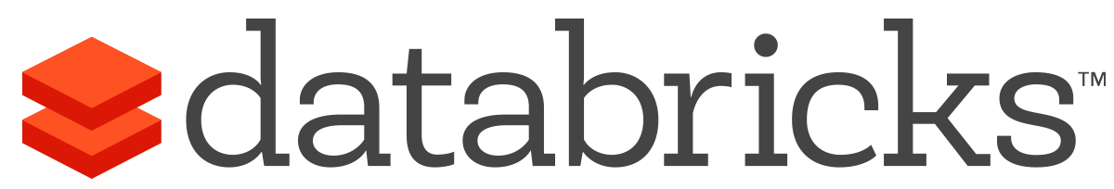


What is Azure Databricks?
A fast, easy and collaborative Apache® Spark™ based analytics platform optimized for Azure
Best of Databricks
Best of Microsoft
Designed in collaboration with the founders of Apache Spark
One-click set up; streamlined workflows
Interactive workspace that enables collaboration between data scientists, data engineers, and business analysts.
Native integration with Azure services (Power BI, SQL DW, Cosmos DB, Blob Storage)
Enterprise-grade Azure security (Active Directory integration, compliance, enterprise-grade SLAs)
Notes:
Azure Databricks features –
Enhance your teams’ productivity
Get started quickly by launching your new Spark environment with one click.
Share your insights in powerful ways through rich integration with PowerBI.
Improve collaboration amongst your analytics team through a unified workspace.
Innovate faster with native integration with rest of Azure platform.
Build on the most compliant and trusted cloud
Simplify security and identity control with built-in integration with Active Directory.
Regulate access with fine-grained user permissions to Azure Databricks’ notebooks, clusters, jobs and data.
Build with confidence on the trusted cloud backed by unmatched support, compliance and SLAs.
Scale without limits
Operate at massive scale without limits globally.
Accelerate data processing with the fastest Spark engine.

Slide 5
Big Data & Advanced Analytics at a glance
Ingest
Store
Prep & Train
Model & Serve
Intelligence
Business apps
Data Factory
(Data movement, pipelines & orchestration)
Cosmos DB
Predictive apps
Blobs
Data Lake
Databricks
HDInsight
Data Lake Analytics
SQL
Custom apps
Kafka
10 01
SQL Database
SQL Data Warehouse
Operational reports
Event Hub
IoT Hub
Machine Learning
Sensors and devices
Analysis Services
Analytical dashboards
Notes:
Azure build-out of DMSA. Supports hybrid\on-premises too through ADF \ Blob \ Stretch.

Slide 6

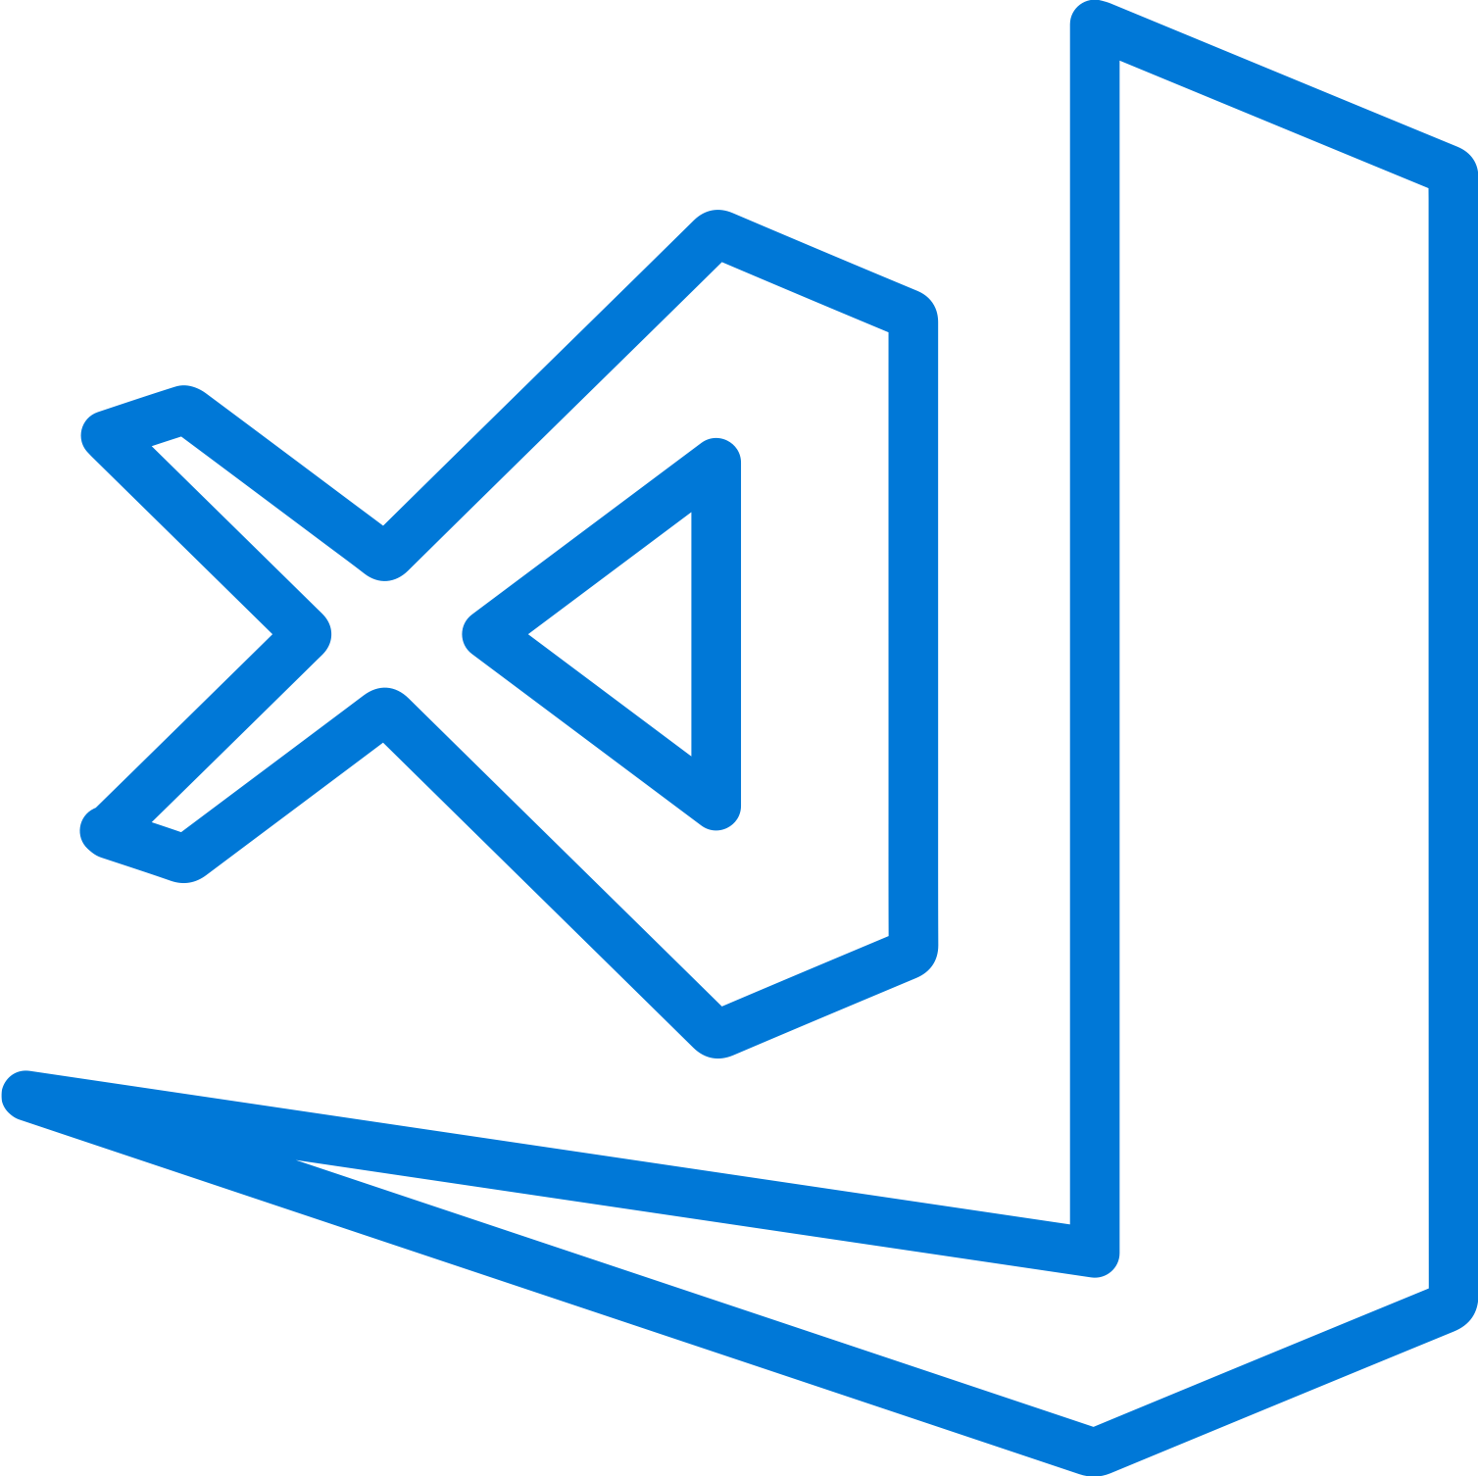
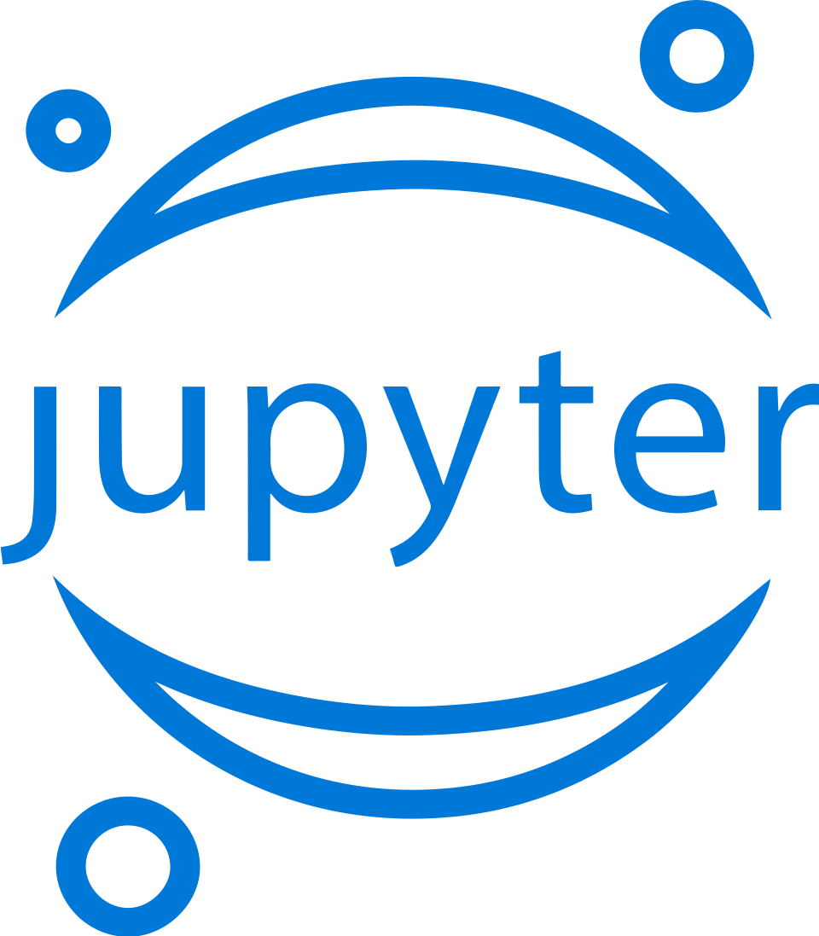



Machine Learning
Domain specific pretrained models
To simplify solution development
…
Vision
Speech
Language
Search
Familiar Data Science tools
To simplify model development
Visual Studio Code
Azure Notebooks
Jupyter
Command line
Popular frameworks
To build advanced deep learning solutions
PyTorch
TensorFlow
Scikit-Learn
ONNX
Productive services
To empower data science and development teams
Azure Databricks
Azure Machine Learning
Machine Learning VMs
Powerful infrastructure
To accelerate deep learning
CPU
GPU
FPGA
From the Intelligent Cloud to the Intelligent Edge

Slide 7
Lab aka.ms/fsidbnotebooks

Slide 8
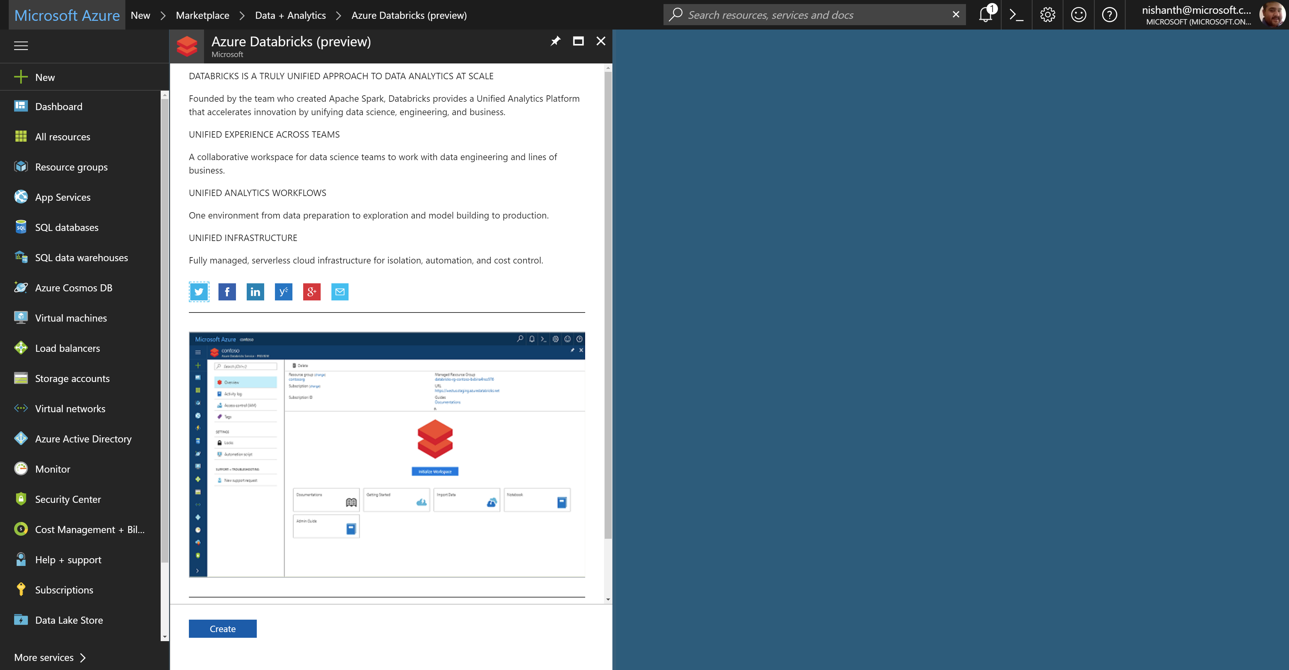
Azure Databricks – service home page

Slide 9
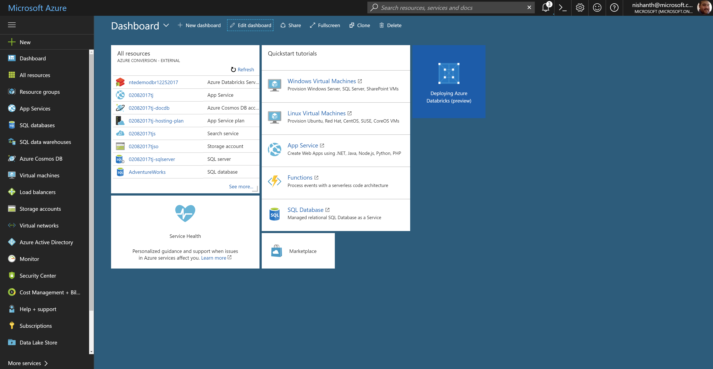
Azure Databricks – workspace deployment

Slide 10
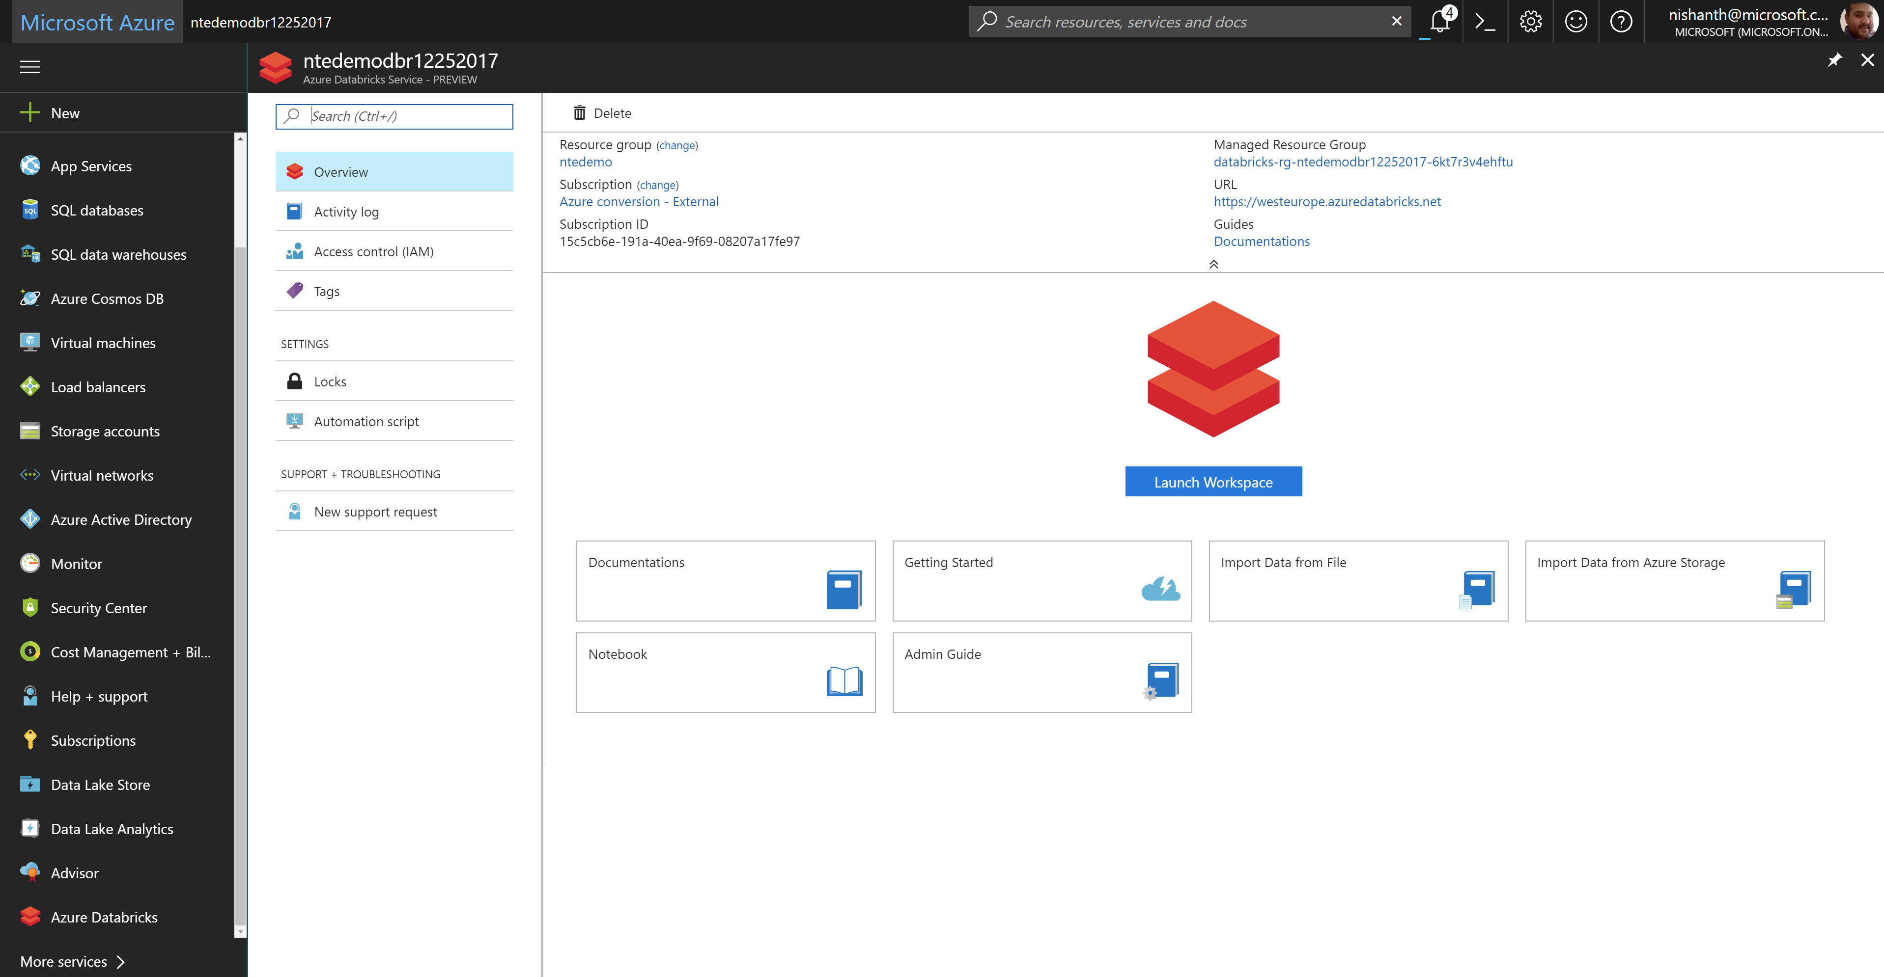
Azure Databricks – launching the workspace

Slide 11
Demo

Slide 12

How to get started
Try a Quickstart or Tutorial at: https://docs.microsoft.com/en-us/azure/azure-databricks/ https://github.com/MicrosoftLearning/databricks-intro
https://github.com/Azure/MachineLearningNotebooks/tree/master/how-to-use-azureml/azure-databricks
Engage Microsoft experts for a workshop to help identify high impact scenarios
Learn more about Azure Databricks www.azure.com/databricks
Notes:
Databricks, founded by the team that created Apache Spark – unified analytics platform that accelerates innovation by unifying data science, engineering & business.
75% of the code committed to Apache Spark comes from Databricks
Unified Runtime
Create clusters in seconds, dynamically scale them up and down.
They’ve made enhancements to Spark engine to make it 10x faster than open source Spark
Serverless- Auto-configured multi-user cluster, Reliable sharing with fault isolation
Unified Collaboration
Overall – a simple & collaborative environment that enables your entire team to use Spark & interact with your data simultaneously
DE – Improve ETL performance, zero management clusters. Execute production code from within notebooks
DS - For data scientists, easy data exploration in notebooks
Business SME – interactive dashboards empower teams to create dynamic reports
Enterprise Security
Encryption
Fine grained Role-based access control (files, clusters, code, application, dashboard)
Compliance
Rest APIs
DE – DBIO, SPARK, API’s , JOBS
DS – Spark and Serverless, Interactive Data Science
Data Products - Everything
Creators of Spark
Training People
Number of Customers
Ingest
Workflow
Schedule / Run / Monitor
Execute
Troubleshoot
Debug
Production Jobs
---------
Ingest, ETL, Scheduling, Monitoring

Slide 13
Q & A

Slide 14
Appendix

Slide 15
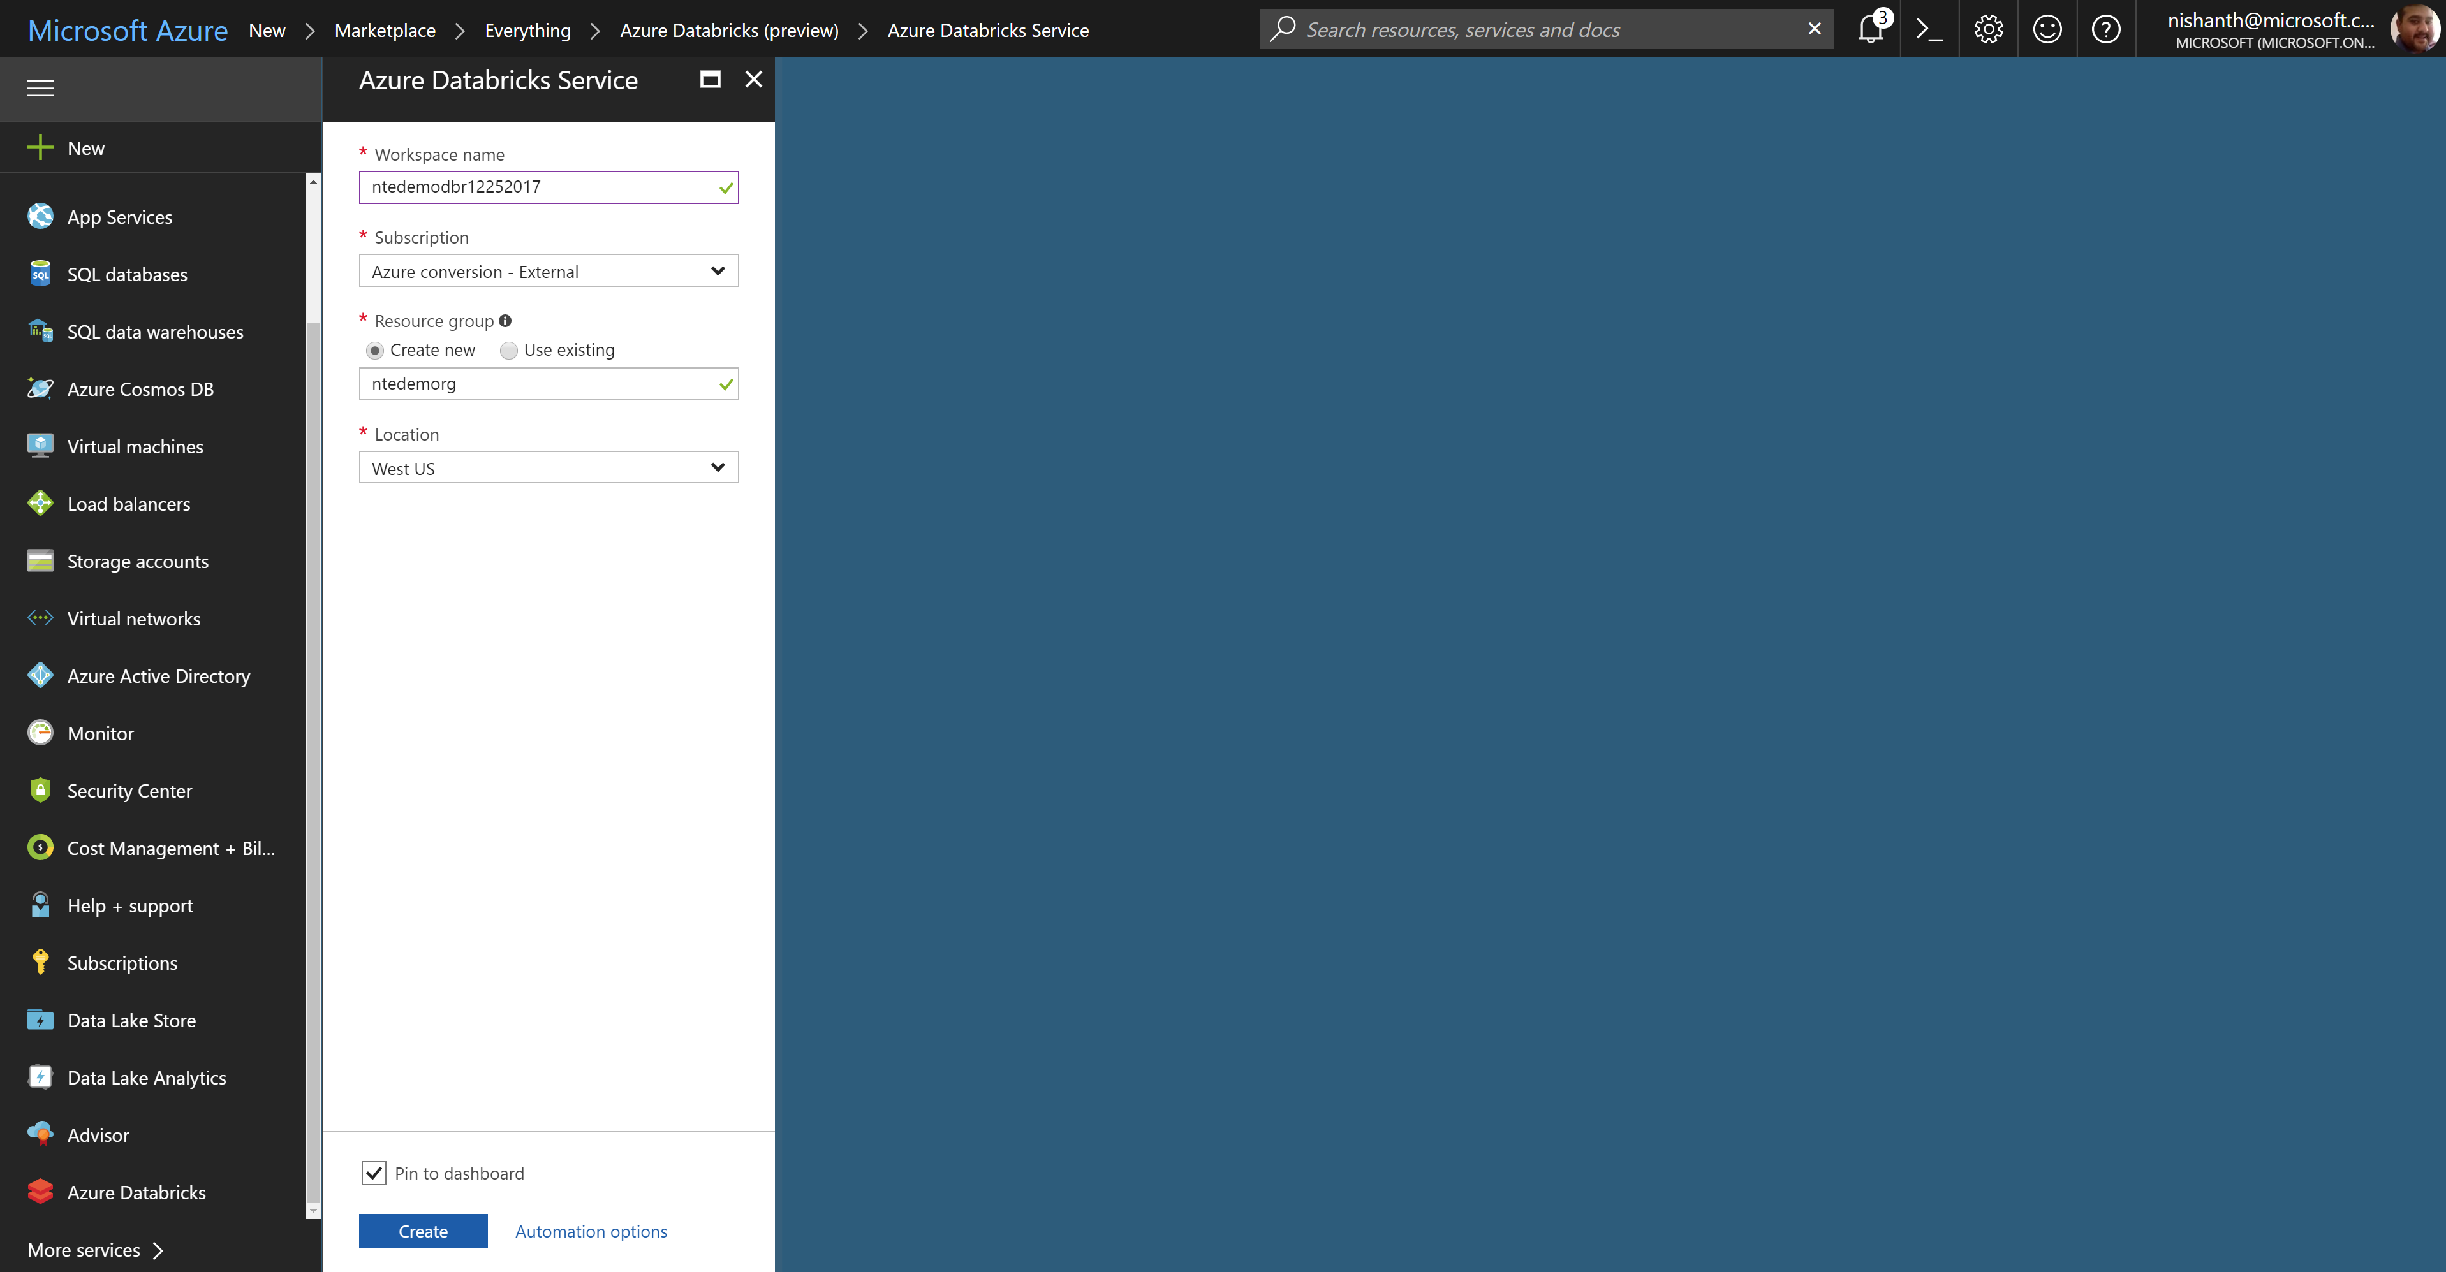
Azure Databricks – creating a workspace

Slide 16
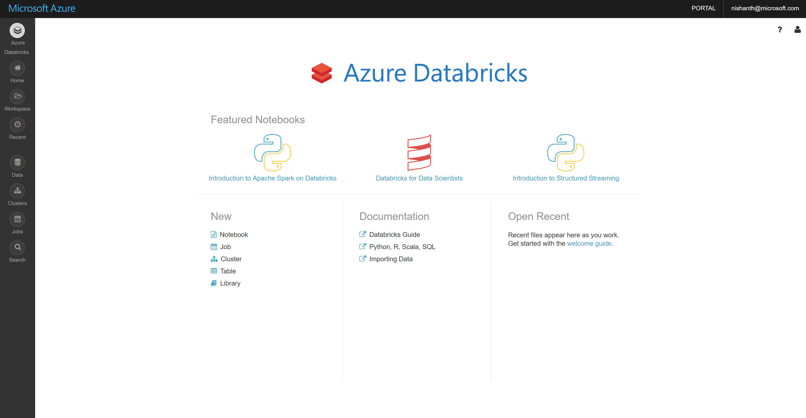
Azure Databricks – workspace home page

